Slide 1
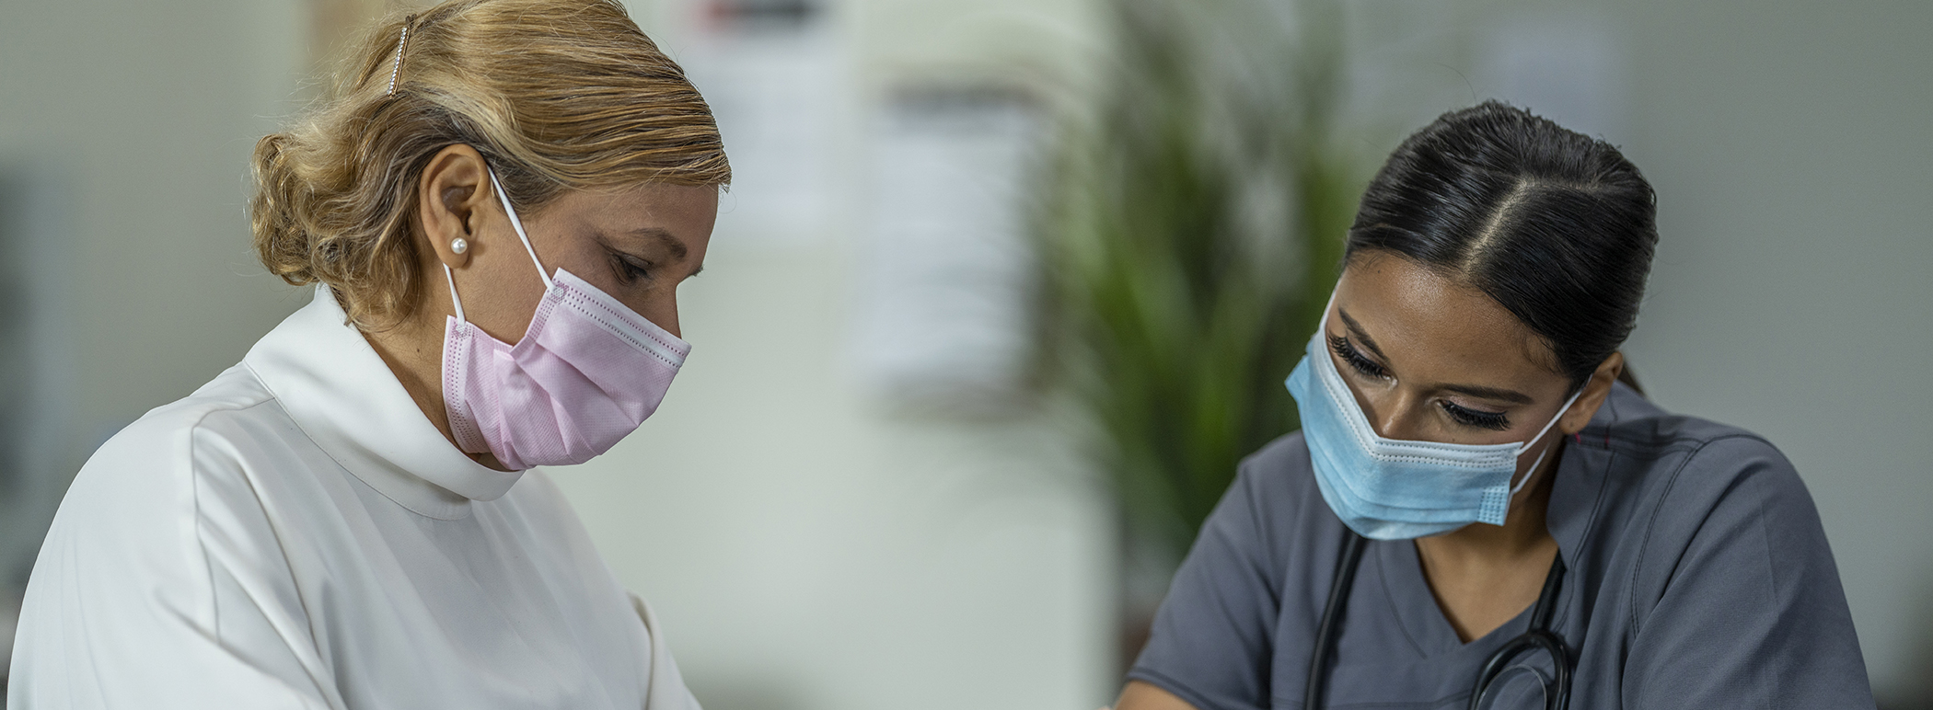
PPE: Gowns and Gloves

Slide 2
Learning Objectives
By the end of this session, participants will be able to:
List 2 reasons why wearing gloves is important for infection control.
Describe 2 ways that gowns are important for infection control.
Differentiate when a gown or gloves are needed as part of an infection prevention and control program.

Slide 3
Key Points
Wearing gloves is important to cover breaks and cracks in your skin that allow germs to penetrate the skin.
Gloves help stop germs from spreading place to place via your hands.
Gowns protect you by keeping germs off your clothes.
Gowns keep you from spreading germs around the facility and to other people.
Double gloves or gowns is NOT recommended by the CDC.
Gowns and gloves are necessary as part of Enhanced Barrier Precautions, Contact Precautions or when providing resident care could put you in contact with blood or body fluids.

Slide 4
Question
Previously we discussed masks and eyewear and asked you to determine what the level of understanding of your shift coaches was on when masks and eyewear may be required in your facility.
What would you describe that level as?
Great
OK
Needs work and I’ve already provided education
Needs work and I haven’t been able to address it yet

Slide 5
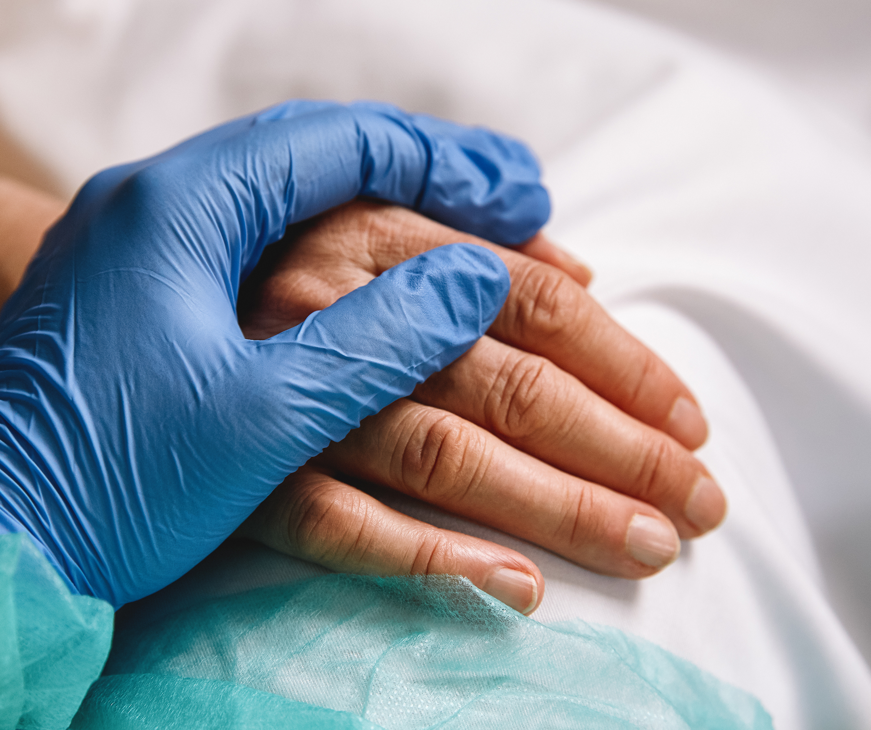
Scenario
You and your shift coach are making rounds when one of your best CNA’s, Mr. Powell, was observed providing care to roommates. He wore gloves while helping with the bathroom needs of Mrs. Jones and properly disposed of his gloves but didn’t wash his hands after doing so. He then proceeded to provide oral care for Mrs. Smith.
Notes:
List some of the potential problems with this activity
How would you start the conversation?

Slide 6
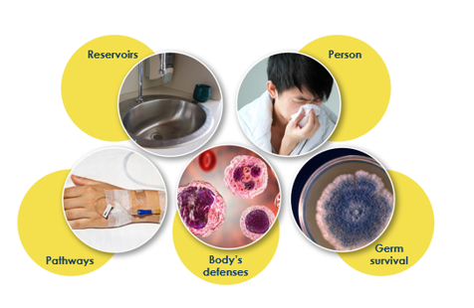
Infection Prevention and Control Aims to Stop the Spread of Germs in Health Care
Pathway:
Touch
Body Defense: break in the skin
Notes:
When addressing gowns and gloves we will be focusing on the touch pathway as a primary source and secondarily if droplets were to be present and then follow the touch pathway. Gloves in particular are also helpful in helping you as a staff person protect yourself if you have any breaks in the skin on your hands that could be a way for germs to bypass the body’s natural defenses.

Slide 7
Gloves
Gloves protect you and keep you from accidentally spreading germs into your work environment.
Covers breaks in skin that would allow germs to bypass body’s defense (skin)
Touch pathway

Slide 8
Gloves
Gloves help stop germs from spreading from place to place while carried on your hands.
But gloves need to be changed
When visibly soiled or contaminated with blood or other body fluid
When damaged from hole, rip, or tear
After completing care with a patient that required gloves as PPE
Moving from work on a soiled body site to a clean body site on the same patient
Gloves need to be the correct size
Glove use must be paired with hand hygiene after removal

Slide 9
Gloves
Gloves are essential part of PPE to disrupt a germ pathway for:
Standard precautions when anticipating contact with:
Blood or body fluids
Mucous membranes
Non-intact skin such as wounds or surgical incision
Insertion point of any indwelling device
Potentially contaminated skin or contaminated equipment
PLUS
Contact Precautions
Enhanced Barrier Precautions
Combined Precautions

Slide 10
Donning and Doffing Gloves
Don
Doff
Gloves should extend to cover the wrist and/or over the gown.
Anticipate outside of gloves are contaminated.
Using a gloved hand grasp the palm area of the other gloved hand and peel off first glove.
Hold removed glove in gloved hand.
Slide fingers of ungloved hand under remaining glove at wrist and peel off 2nd glove over first.
Discard gloves in a waste container.
Perform hand hygiene.

Slide 11

Gowns
Gowns protect you from germs.
Gowns protect others by keeping germs out of the environment and from being transported on your clothes between residents.
Gowns limit the touch pathway

Slide 12
Gowns
Gowns need to be changed
When visibly soiled or contaminated with blood or other body fluid
When damaged from hole, rip, or tear
After completing care with a resident that requires a gown as PPE
Gowns should fit properly so that it doesn’t touch other surfaces while you are wearing it. ???

Slide 13
Gowns
A gown is essential part of PPE to disrupt a germ pathway for:
Standard precautions when anticipating contact with:
Blood or body fluids
Mucous membranes
Non-intact skis such as wounds or surgical incision
PLUS
Contact Precautions
Enhanced Barrier Precautions
Combined Precautions

Slide 14
Donning and Doffing a Gown
Don
Doff
Gowns should cover:
Torso
Legs to the knees
Arms to the end of wrist
Wrap around back
Slide gowns on with opening to back, fasten around the back of the neck and waist.
Unfasten gown
Pull away from neck and shoulders, touching inside of gown only
Turn gown inside out
Fold or roll into a bundle and discard
Perform hand hygiene before leaving resident’s environment

Slide 15
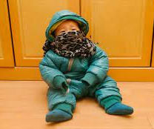
Gowns and Gloves
Should NOT:
Be worn out of a resident room after providing care.
Doubled up to “add protective layers”
Expose skin because they do not fit correctly or be too long to be a hazard.

Slide 16
Breakout Group Discussion
What common gown and glove wearing/disposing/replacing issues do you find?
What strategies have you found successful for clarifying what situations need gloves and which don’t?

Slide 17
Homework
In a huddle next week- talk about the importance of proper glove wearing.
During the week- create a positive reward activity (points, treats, shout outs- what works for your group?) to recognize people who are the “stars” on your unit for doing it correctly.

Slide 18
Resources
CDC, Sequence for Personal Protective Equipment:
https://www.cdc.gov/hai/pdfs/ppe/ppe-sequence.pdf
CDC PPE 101
https://www.cdc.gov/infectioncontrol/pdf/strive/PPE101-508.pdf
CDC Hand Hygiene in Healthcare Settings
https://www.cdc.gov/handhygiene/providers/index.html

Slide 19
Objectives
Huddles
Coaching
PPE
Key Points
Precautions
Airborne Precautions
Droplets Precautions
Dirty Hands/Contact/
Precautions
Enhanced Barrier
Precautions
Breakout Groups
Homework
Resources
Strategies
Introduction

Slide 20
Objectives
Huddles
Coaching
PPE
Key Points
Precautions
Airborne Precautions
Droplets Precautions
Dirty Hands/Contact/
Precautions
Enhanced Barrier
Precautions
Breakout Groups
Homework
Resources
Strategies
Introduction

